Slide 1
Sp4ce Adventures
By: Team Unity
Cale Anderson
Kaleb Bodisch
Chance Roberts
Tamim Shaban

Slide 2
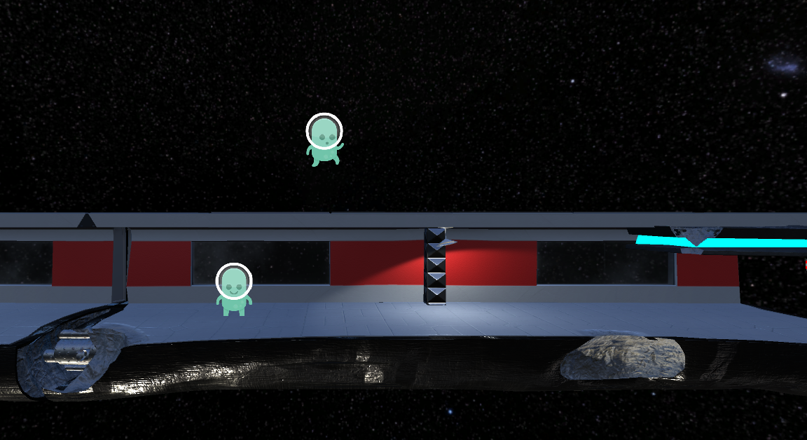
Sp4ce Adventures
Side scroller
Multiplayer
Power-ups
Obstacles

Slide 3




Tools
-Unity
-Github/Github Desktop
-Pivotal
-Slack
- MonoDevelop - Unity
-Coding Blocks
Languages:
-C Sharp
-Javascript

Slide 4
Challenges
-Syncing Object instantiation between multiple players
-Online multiplayer - Converted to LAN
-Linking scenes without destroying prefabs
-Communication
-Learning Unity

